Slide 1
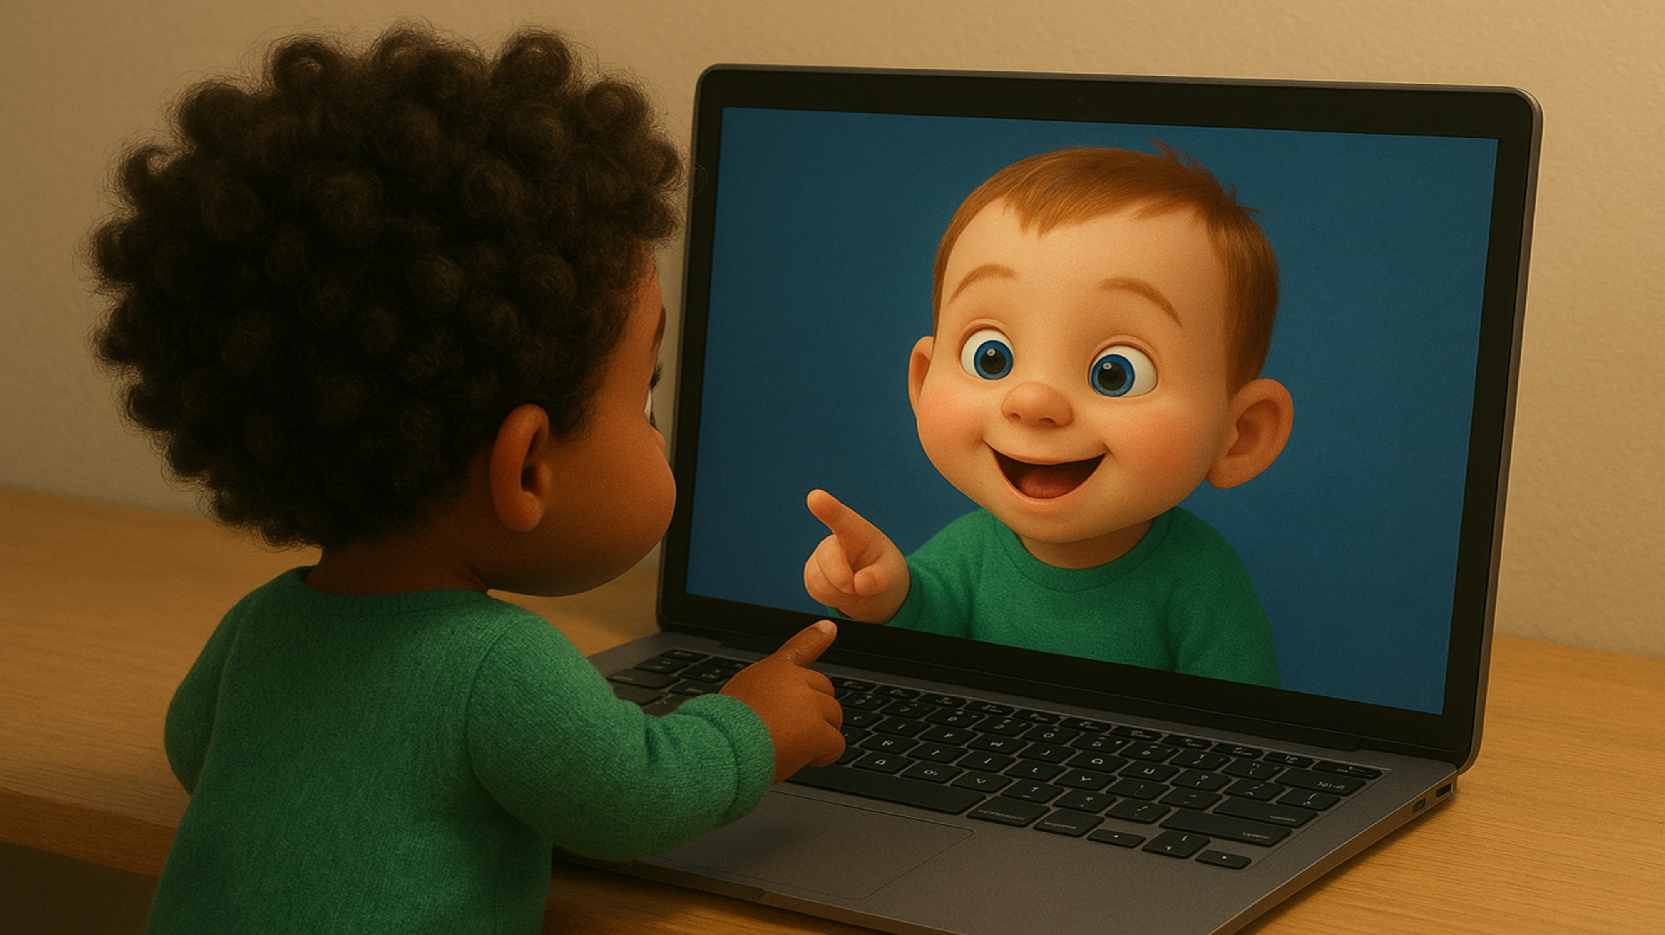

Notes:
Hi there and welcome to our study!
In this study, we are interested in what babies do when they see themselves and other babies on the screen. Let me walk you through what’s going to happen.

Slide 2


Attention-getter (~10 seconds)
Notes:
First, your child will see an exciting jumping dot moving around the screen; it’s called an attention-getter, because we use it to get your child to attend to the screen.

Slide 3


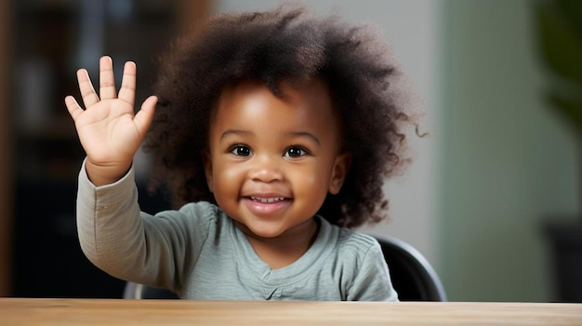
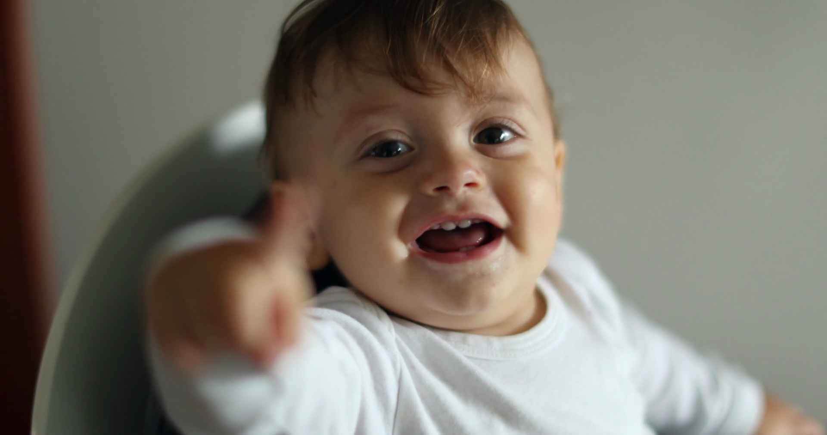
~3 min
view SELF
view OTHER INFANT
ends automatically
Notes:
Then, for the next 3 minutes, your child will see a live webcam feed of themselves on the screen, with some music playing in the background. Halfway in, the image on the screen will change to a video of ANOTHER infant who’s sitting in front of the screen, just like your child. Your child will see this video for 3 minutes while the music keeps playing. After a total of 6 minutes, right as the music ends, the videos will stop. That’s really all your child will do and see in this study, super simple!

Slide 4
Questions
Notes:
At the very end, we will ask you a few quick questions to close out the study.

Slide 5
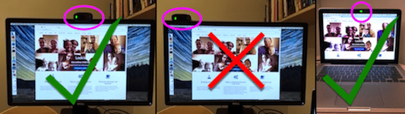
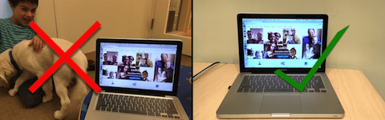
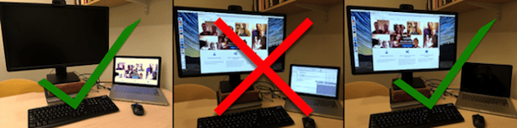
Use only ONE monitor (turn others off)
Quiet place with minimal distractions (e.g., no toys, siblings, pets, windows)
Webcam should be centered
Notes:
During the study, there are a few important things to keep in mind:
First, please find a quiet place to complete the study, away from other interesting things.
Make sure your webcam is centered on the screen.
Also, if your setup has more than one monitor, please make sure to use only ONE.

Slide 6
Please avoid interrupting your child’s responses or telling them what to do!
Notes:
Second, please let your child be. Once the live video feed starts, it is very important that you avoid interacting with your child or telling them what to do – we want to observe what your child does on their own.
If your child looks at you, you can smile and nod, but please don’t talk or point to the screen or try to change their behavior in any way.

Slide 7
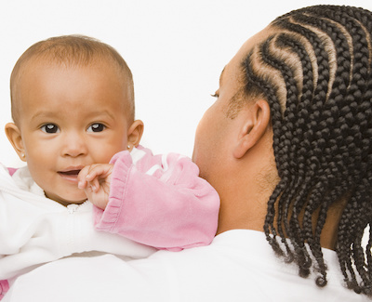

Option 1: Your child can sit on a high chair in front of the camera by themselves!
Option 2: You can hold your child over your shoulder while facing away!
Please make sure your child’s face is the only face on the screen!
to stop!
Notes:
Third, please make sure that the only face on the screen is your child’s face. This means you or any other family members should stay out of the camera’s view
There are a few ways to do this.
First, if your child is old enough to sit on their own, you can have them sit in a high chair in front of the camera just like this child! (show image)
Alternatively, if your child is very young, you can hold them and have them face the camera over your shoulder while YOU face away from the camera, like this child!
If you have other ideas, that’s great too! The important thing is to make sure that the child’s face is the only face on the screen.
Lastly, if your child is getting too distracted or distressed at any point, you can stop the session by pressing E on your keyboard.

Slide 8
Press ‘continue’ to start! We hope you and your child have fun!
Notes:
Alright - you’re all set! Thank you for participating, and we hope you and your child have fun!

